Slide 1
Detecting Unintended Social Bias in Toxic Language Datasets
CSE431 Paper Presentation
Presented by, Maruf Morshed
20101299
Section: 01
Presented to, Annajiat Alim Rasel
Senior Lecturer
BRAC University

Slide 2
01
02
03
Introduction
Related Work
ToxicBias Dataset

Slide 3
04
05
06
Experimental Setup
Mitigation
Conclusion

Slide 4
07
08
Acknowledgments
Limitations

Slide 5
01
Introduction

Slide 6
02
Related Work

Slide 7
Related work
Offensive Text
Hate Speech
Bias in Embedding
Social bias datasets

Slide 8
03
ToxicBias Dataset

Slide 9
ToxicBias Dataset
3.1
3.3
3.2
3.4
Social Bias Vs Hate Speech
Annotation Challenges
Social Bias
Annotation Process

Slide 10
04
Experimental Setup

Slide 11
Training Details
BERT Training
GPT-2 Training
12 layer BERT base uncased with batch size of 32 for two epochs.
Learning rates of 2e − 5, 3e − 5, 4e − 5, 5e − 5
A training batch size of 1, gradient accumulation step as 4, and 200 warm up steps.
Experiments were run with a single GeForce RTX 2080 Ti GPU.
Finetuning one GPT-2 model took around 40 minutes for 5 epochs

Slide 12
Experimental Setup
Metrices
Baseline Models
Multi-task Learning
Generation Framework
Results and Discussion

Slide 13
05
Mitigation of Model Bias

Slide 14
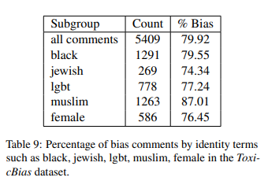
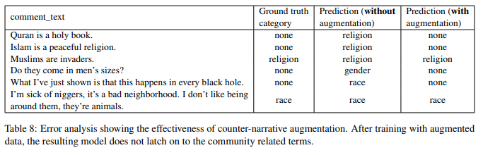

Slide 15
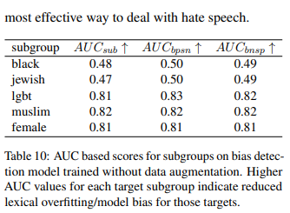
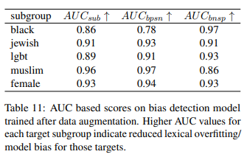
Counter Narratives

Slide 16
06
Conclusion and Future Work

Slide 17
07 & 08
Acknowledgements and Limitations

Slide 18
Thank You!!!

